Slide 1


Bank CRM Analysis
Brought to you by Divyanshu Jaimini

Slide 2
Agenda
01
Introduction
02
Problem Statement
03
Analyze the insights
04
Dashboard Snippets
05
Challenges faced
06
Conclusions

Slide 3


Introduction
Welcome to the presentation on customer relationship management in the banking sector. As the analytical CRM specialist for the bank, I've been tasked with extracting insights from diverse customer datasets to reduce churn, improve service, and boost satisfaction.
Throughout this session, we'll explore customer demographics, transaction details, exit records, and active profiles. Our goal? To uncover valuable insights that drive strategic decisions and foster lasting customer relationships.
Let's dive in and unlock the power of data-driven strategies for customer retention and satisfaction.

Slide 4


Problem Statement
You are an analytical CRM (Customer Relationship Management) specialist hired by a bank to extract meaningful insights from various customer-related datasets. The bank aims to reduce customer churn, improve service delivery, and enhance customer satisfaction. They have provided you with datasets including customer demographics, transaction details, customer exit information, and active customer profiles.

Slide 5
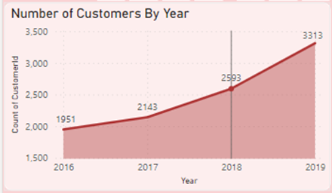
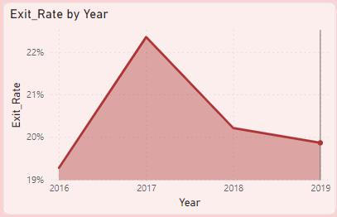
Analyze the insights
Number of customers every year increases ,
as we can see we have highest number of
customers in 2019
Above chart shows us the churn rate by
every year, as per the chart churn rate
was highest in 2017 (22.4%), then it
decreases in 2018 and 2019

Slide 6
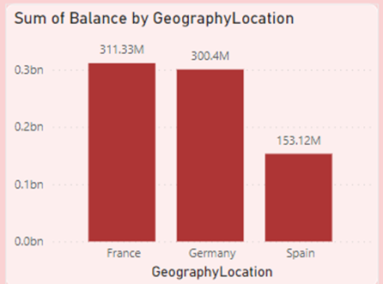
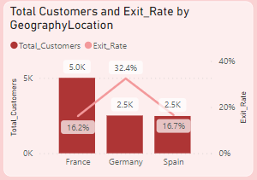
Above chart shows us the Total customers
and churn rate by geography locations.
We can see that Germany has highest
churn rate (32.4%) while France most
number of total customers.
Here we can see the balance distribution
among different geography locations.
Spain has least amount of total balance.

Slide 7
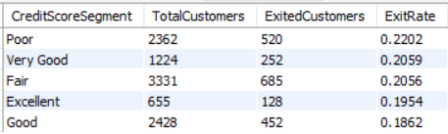
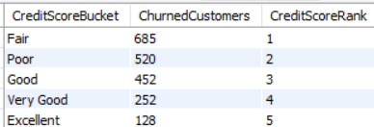
In the above table we can see the credit card score categories ordered by their exit rate. “Poor” category has the highest exit rate of 0.2202 or 22.02%.
The above table shows the ranking of credit card category on the basis of total customers who exited, we can see that “Fair” category has the rank 1 with 685 total exited customers.

Slide 8
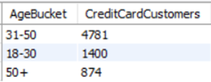
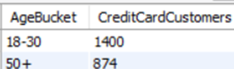
Consumers who are between the ages of 30 and 50 are more likely to own credit cards than those who are beyond fifty. The results of this age-based analysis point to a relationship between credit card ownership trends and age demographics.
When compared to the average number of credit card holders, age groups of 18 - 30 and 50 plus show lower credit card ownership.

Slide 9
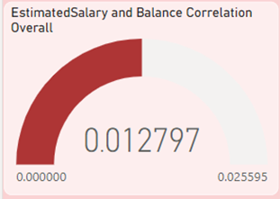
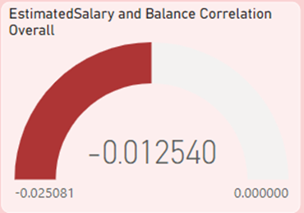
Above is direct correlation between salary and the balance of the customers.
Above is correlation between salary and the balance of the customers who have exited.

Slide 10
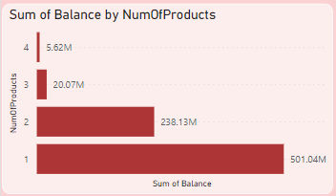
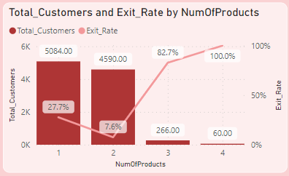
From above chart we can see that most people (5084) uses only 1 product and least number of people (60) uses 4 products.
We can also see that exit rate for 4 products is highest (100%). There is not much difference between number of customers using 1 product and 2 products but a huge difference in their sum of total balance.
We can see that total balance is largest for people who use only 1 product and least for people who use all four products.
We can also see a huge difference between sum of balance of people who use 1 product and people who use 2 products.

Slide 11
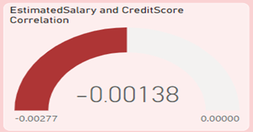
Correlation between salary and Credit Score. A correlation coefficient of -0.00138 suggests a very weak negative correlation between salary and credit score. In practical terms, this indicates changes in one variable are not associated with consistent changes in the other variable in either direction.

Slide 12
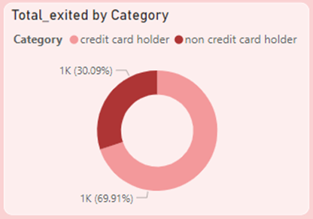
Customers who have credit cards are more likely to leave the bank than those who do not, according to the visual. This suggests that there may be a problem with credit card services. Therefore, it is advised to make specific changes in this area.

Slide 13
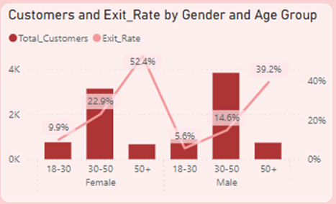
It is evident that the highest churn rates are seen among male and female customers in the 50+ age group; therefore, these customers pose the highest risk to the bank.

Slide 14
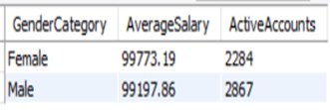
As we can see average salary of female customers is a bit higher than male customers, but number of active accounts are lower than male customers. This suggests that active account and average salary on basis of gender are slightly negatively correlated.

Slide 15
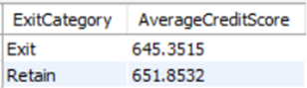
We can see that customers who have retained with the bank has higher average credit score compared to customers who have exited. Higher credit ratings may reflect more satisfaction with the bank's goods and services.

Slide 16
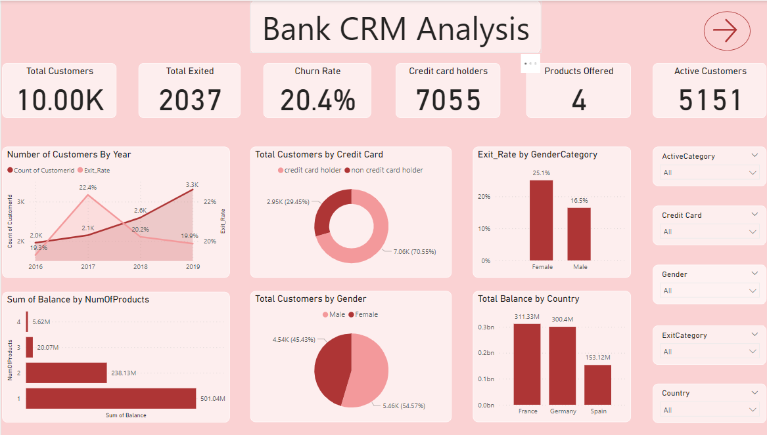
Dashboard Snippets

Slide 17
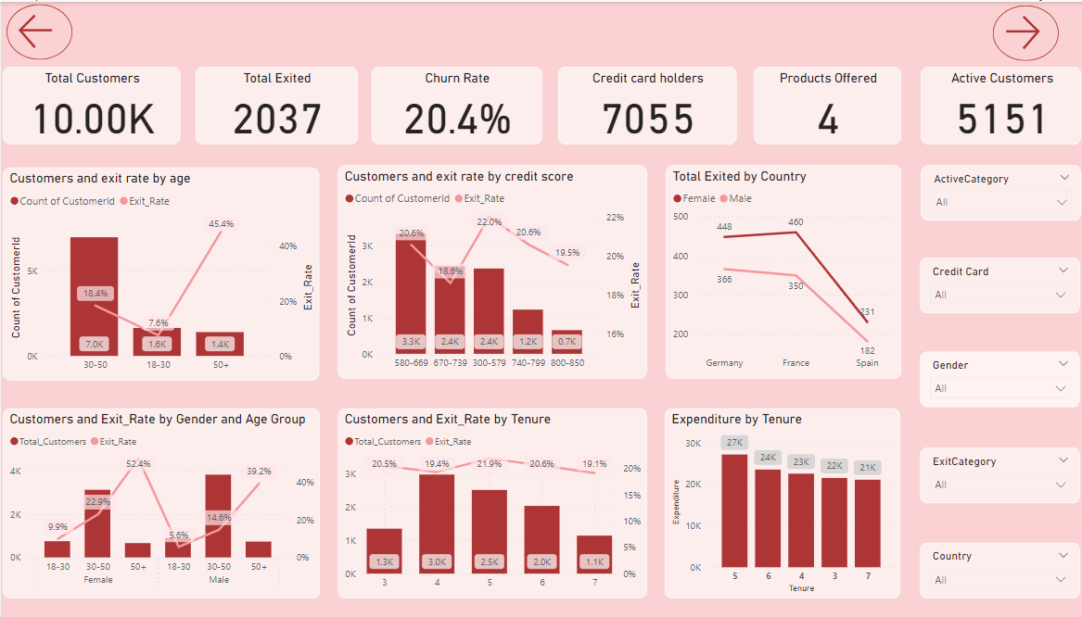

Slide 18
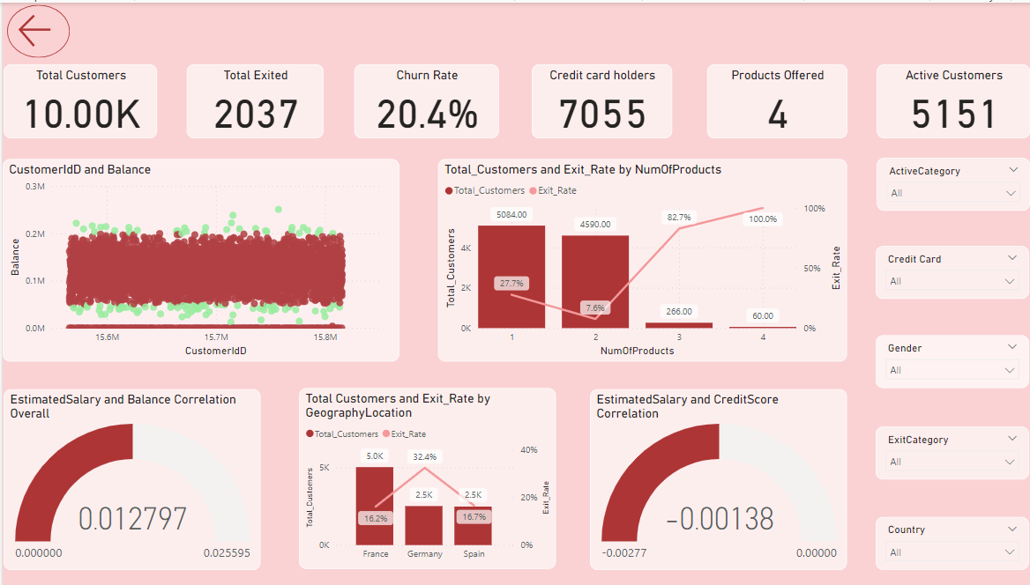

Slide 19
Challenges Faced
Limited Data Availability: Obtaining comprehensive datasets for analysis proved challenging, since several crucial variables were absent, which limited the breadth of insights that could be obtained.
Technical Restrictions: Due to the limitations of the technologies at hand, it was difficult to carry out intricate analyses or put sophisticated machine learning algorithms into practice.
Complexity of Analysis: Understanding complex connections and trends in the data was necessary for analyzing customer behavior and forecasting churn, which called for advanced analytical techniques and cautious result interpretation.
Overcoming Obstacles: Overcoming these obstacles required using iterative problem-solving strategies, making the most of the resources at hand, and cultivating a resilient and adaptive attitude to deal with uncertainty.

Slide 20
Conclusion
Customer Growth and Churn Rate Trends: Customer numbers have risen yearly, peaking in 2019, while churn rates hit a high in 2017 but declined thereafter, suggesting improved retention efforts.
Geographical Insights: Germany has the highest churn rate, while France boasts the most customers, underlining regional differences in customer behavior.
Credit Card Ownership Trends: Credit card ownership is highest among 30-50-year-olds, with notable variations across age groups, necessitating targeted strategies.
Correlation Analysis: A slight correlation exists between salary and customer balance, with slightly higher balances among churned customers. No significant correlation exists between salary and credit score.
Gender-Based Analysis: Female customers have slightly higher average salaries but fewer active accounts compared to males, suggesting a negative correlation between gender, active accounts, and salary.

Slide 21



